Slide 1
Energy 101: Industry and Recruiting Overview
September 6, 2016

Slide 2
Upstream

Slide 3
Energy Value Chain
Exploration
Production
Processing
Transportation
Refining & Retail
Upstream
Midstream
Downstream
Graphic source: http://en.wikipedia.org/wiki/Profire_Energy
Notes:
http://en.wikipedia.org/wiki/Profire_Energy source

Slide 4
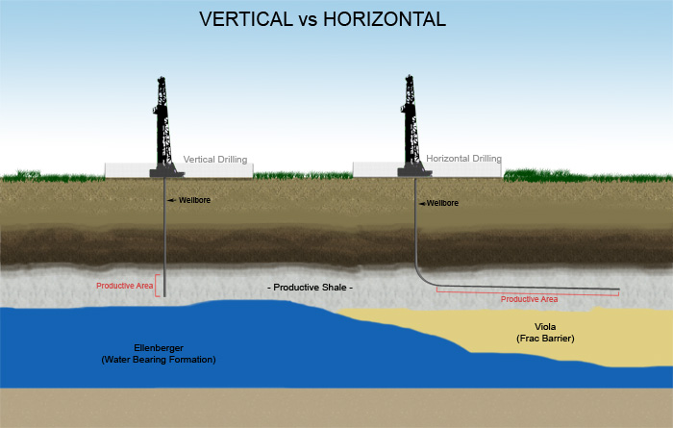
Conventional vs. Unconventional Drilling

Slide 5
Companies in the Upstream Space
Integrated Oil and Gas Companies (Majors)
Equipment and Service Providers
Independent E&P Companies
Notes:
Logos of operators, independent E&P companies, service providers- and possible careers for mbas

Slide 6
MBA Roles in E&P
Corporate Finance Roles- Treasury, Controllers
Business Development and Planning
Investment Appraisal
Supply Chain
Trading
Project Management
Marketing
Investor Relations
Much More!
Notes:
Logos of operators, independent E&P companies, service providers

Slide 7
Midstream

Slide 8
Midstream
Exploration
Production
Processing
Transportation
Refining & Retail
Upstream
Midstream
Downstream
Graphic source: http://en.wikipedia.org/wiki/Profire_Energy
Notes:
http://en.wikipedia.org/wiki/Profire_Energy source

Slide 9
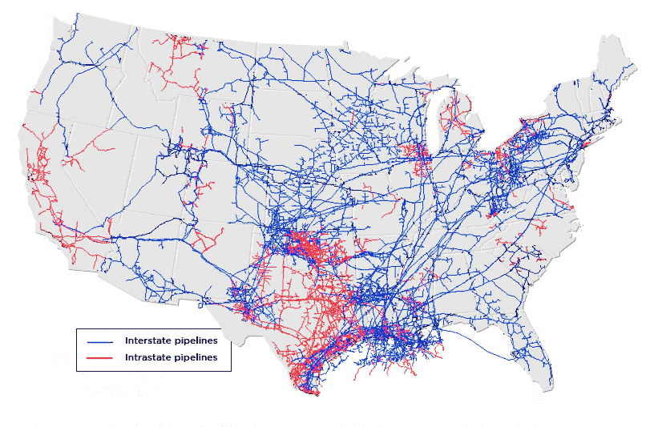
Transportation/Transmission

Slide 10
Processing and Transportation Companies

Slide 11
Downstream

Slide 12
Energy Value Chain
Exploration
Production
Processing
Transportation
Refining & Retail
Upstream
Midstream
Downstream
Graphic source: http://en.wikipedia.org/wiki/Profire_Energy
Notes:
http://en.wikipedia.org/wiki/Profire_Energy source

Slide 13
What is Downstream?
Downstream is the process of taking unrefined inputs and turning them into finished products ready for consumers
Includes refining, distribution and trading, and petrochemicals
Notes:
http://www.youtube.com/watch?v=oADTmdTyrFU
Unconventional plays-
Heavy Oil
Coalbed Methane
Shale Gas
Oil Shale
Gas Hydrates

Slide 14
Companies in the Downstream Space
Integrated Oil and Gas Companies (Majors)
Refiners and Other Downstream Companies
Notes:
Logos of operators, independent E&P companies, service providers- and possible careers for mbas

Slide 15
Renewables

Slide 16
Renewable Energy Sources
Power Generation | Heating | Transportation
Wind Solar Hydropower Geothermal | Geothermal Solar water heating | Ethanol Biodiesel
“Renewable Energy” is a broad term, be specific about what category/resource you are targeting
As with Oil and Gas, there is a complex value chain associated with each resource; be specific about your interests
Actively research industry trends; familiarize yourself with economic drivers and regulatory implications
JGSB has not historically placed MBA candidates at renewable energy companies; leverage your resources/network wisely
Focus on areas where MBAs place well: Finance, Supply Chain, EPC

Slide 17
Renewable Power Generation
Solar Energy Companies
Wind/Geothermal Energy Companies
Notes:
Logos of operators, independent E&P companies, service providers- and possible careers for mbas

Slide 18
Education

Slide 19
Educational Materials
Texts
Nontechnical Guide to Petroleum Geology, Exploration, Drilling & Production
Author: Norman J. Hyne, Ph.d.
http://www.pennwellbooks.com/petroleum2.html
Periodicals
Oil & Gas Investor
North American Shale Quarterly
Midstream Business
Energy Speaker Panels & Presentation Decks
Posted regularly to Energy Club Owl Space page

Slide 20
Educational Materials
Awesome Websites
www.rigzone.com
www.fuelfix.com
www.decomworld.com
www.pennenergy.com
www.powermag.com
www.ocean-news.com
www.onepetro.org/mslib/app/search.do
www.geoart.com
Mobile Apps (free via iTunes store)
Baker Hughes Rig Data
Schlumberger Oil Field Glossary

Slide 21
Career Development
Read everything
Think globally about energy issues
Interview Prep (schedule TBD)
CMC Resources & Networking
Class of 2017 Internship Report (see handouts)
Class of 2016 Employment Report
Research Companies, Transaction Headlines, Industry News
Rice Finance Center – Bloomberg, FactSet, Cap IQ
Student Discounts – The Economist, WSJ Print & Online
Review Investor Relation Pages – 10-K’s, Press Releases, etc.
Attend Events – REFS, Baker Institute, Guest Speakers

